Slide 1





AMAZON SALES REPORT
PRESENTED BY:AMRITA SAMUEL

Slide 2
INTRODUCTION
This project involves a comprehensive analysis of Amazon sales data using SQL to uncover key business insights. By leveraging real-world e-commerce data, the analysis explores trends in revenue generation, category-wise performance, fulfillment efficiency, and customer order patterns. Advanced SQL techniques such as window functions, aggregation, ranking, and conditional filtering were used to answer critical business questions—like identifying top-performing SKUs, tracking monthly growth, and comparing average order values. The project showcases strong data querying and analytical skills relevant for data-driven decision-making in the retail and e-commerce domain.

Slide 3

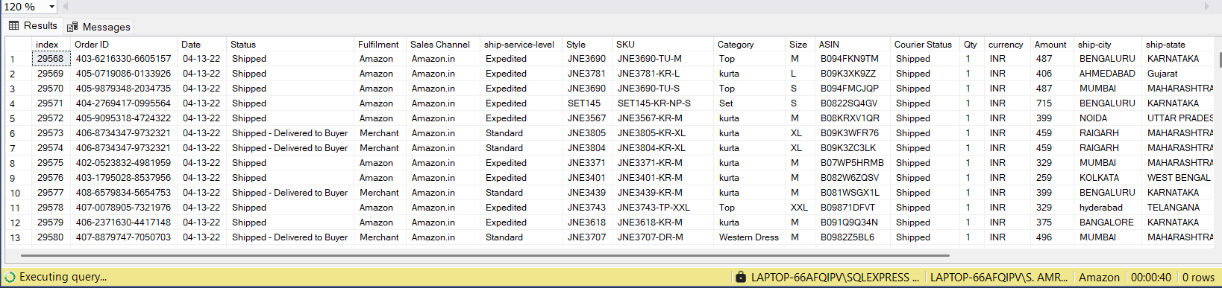
EASY LEVEL Q’S
1. LIST ALL ORDERS PLACED IN THE YEAR 2022

Slide 4
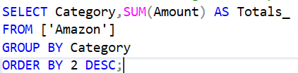
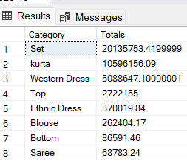
2.FIND THE TOTAL REVENUE GENERATED PER PRODUCT CATEGORY.

Slide 5

3.COUNT THE NUMBER OF UNIQUE ORDER DATES.

Slide 6
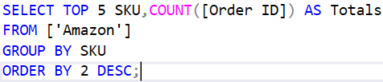
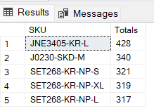
4.RETRIEVE THE TOP 5 SELLING PRODUCTS BY ORDER COUNT.

Slide 7
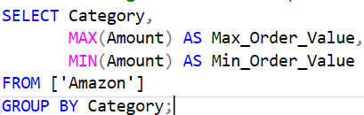
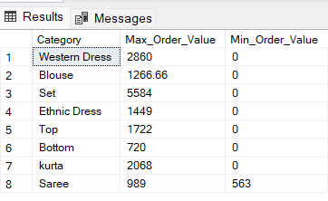
5.FIND THE HIGHEST AND LOWEST PRICED ORDERS PER CATEGORY.

Slide 8
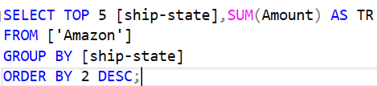
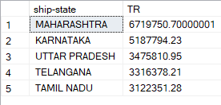
MEDIUM-LEVEL SQL QUESTIONS
1. WHICH 5 STATES HAVE THE HIGHEST TOTAL REVENUE?

Slide 9
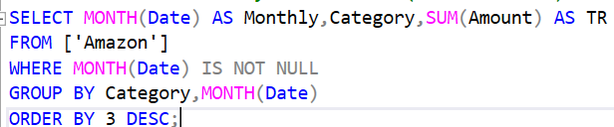
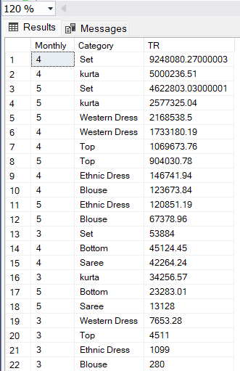
2. WHAT IS THE MONTHLY SALES TREND (TOTAL REVENUE) ACROSS ALL CATEGORIES?

Slide 10
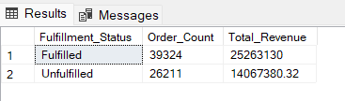
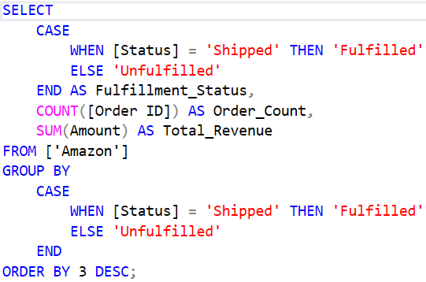
3. HOW MANY FULFILLED VS UNFULFILLED ORDERS ARE THERE, AND WHAT’S THEIR REVENUE?

Slide 11
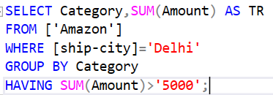
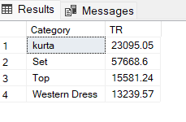
4. LIST ALL PRODUCTS SHIPPED TO 'DELHI' WITH REVENUE MORE THAN ₹5000.

Slide 12

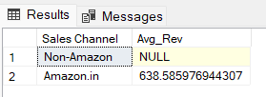
5. WHAT IS THE AVERAGE ORDER VALUE BY SALES CHANNEL (ONLINE VS OFFLINE)

Slide 13
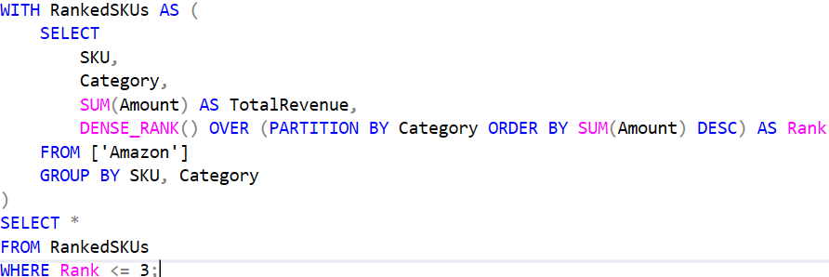
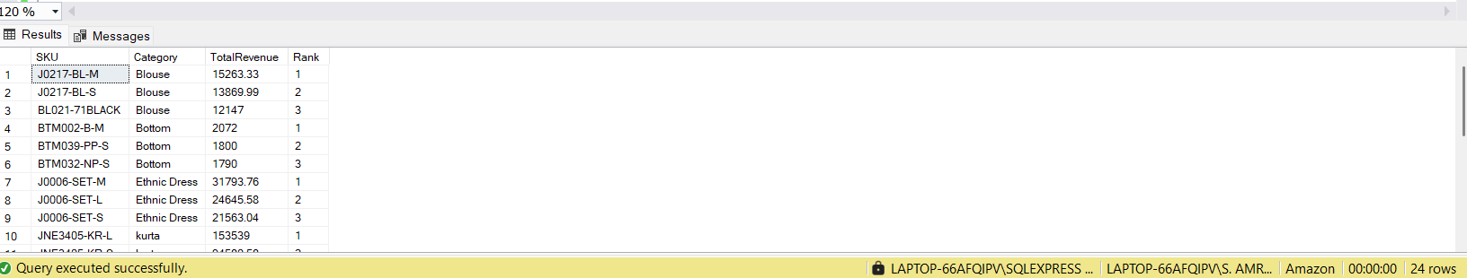
HARD-LEVEL SQL QUESTIONS
1. FIND THE TOP 3 BEST-SELLING SKUS BY TOTAL REVENUE IN EACH CATEGORY.
(USE RANK() OR DENSE_RANK() OVER WINDOW PARTITIONED BY CATEGORY.)

Slide 14
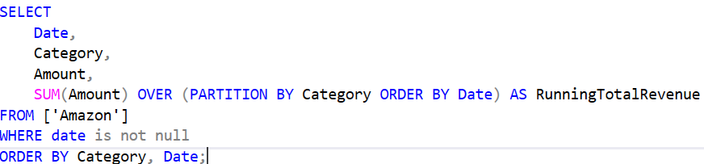
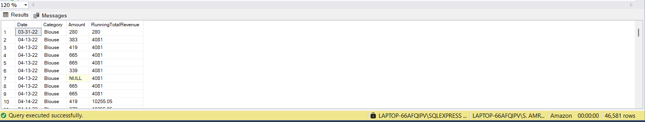
2.COMPUTE THE RUNNING TOTAL (CUMULATIVE REVENUE) PER CATEGORY OVER TIME.
(Use SUM(Amount) over PARTITION BY Category ORDER BY Date.)

Slide 15
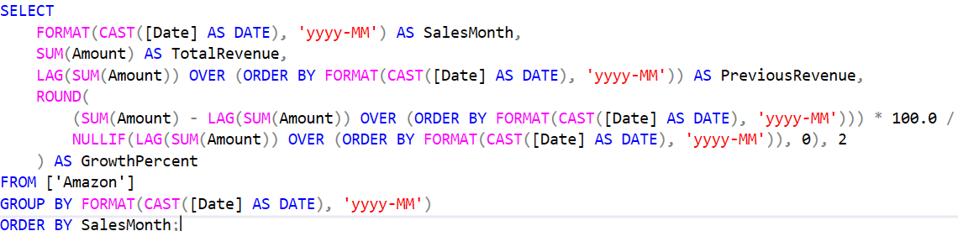
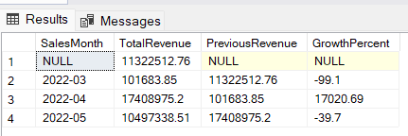
3. FIND THE MONTH-OVER-MONTH GROWTH RATE IN REVENUE.
(Use LAG() to get previous month's revenue and calculate growth %.)

Slide 16
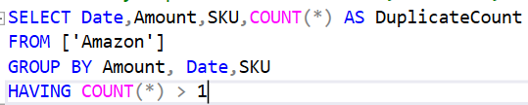
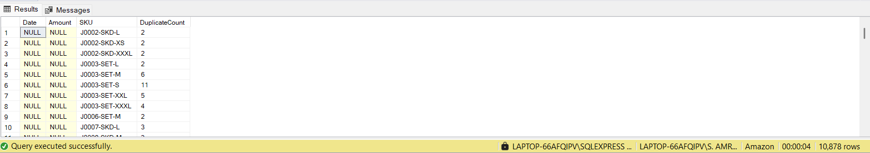
4.IDENTIFY DUPLICATE ORDERS — I.E., SAME SKU, AMOUNT, AND DATE APPEARING MORE THAN ONCE.

Slide 17
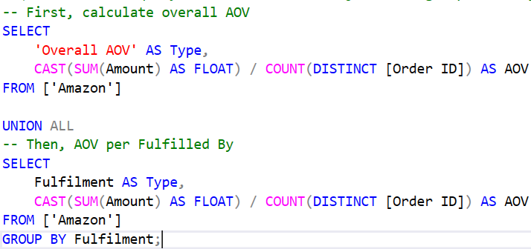
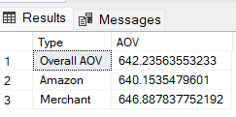
5.GET THE AVERAGE ORDER VALUE (AOV) FOR EACH FULFILLMENT TYPE AND SHOW HOW IT COMPARES TO THE OVERALL AOV.
(Use CTE or subquery for overall AOV and join with grouped AOV by Fulfilled By.)

Slide 18
CONCLUSION
This project provided a comprehensive analysis of Amazon sales data using SQL, focusing on essential business metrics such as revenue trends, top-performing products, category-wise performance, and fulfillment efficiency. By leveraging SQL functionalities like aggregation, window functions, and date-based filtering, we uncovered key insights into customer purchasing behavior, monthly sales patterns, and order fulfillment dynamics. The findings offer valuable inputs for inventory planning, marketing strategies, and operational improvements, showcasing how data-driven decisions can enhance e-commerce performance.

